Slide 1
PORTFOLIO
Ravi Ramesh Pathak
Ph.D., M.B.A.
Web Page: www.ravirameshpathak.com
Email: contact@ravirameshpathak.com
Mobile: +1-347-409-0817

Slide 2
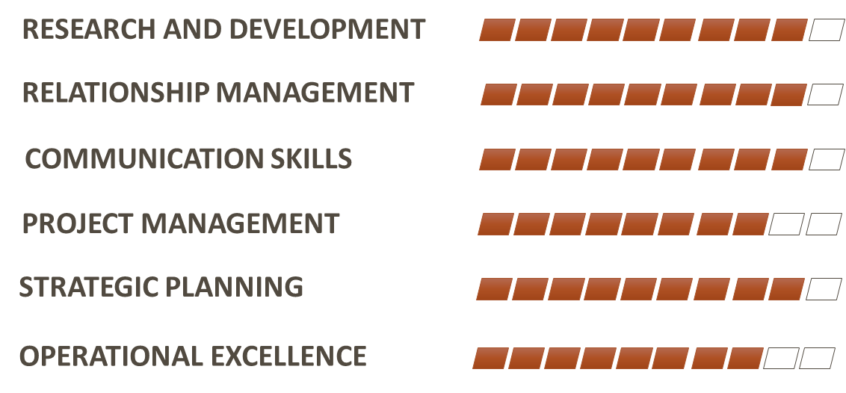
PROFESSIONAL EXPERIENCE
2016
2017
2018
2020
2022
Director
Advanced
In Vivo Models Core
Baylor College of
Medicine
MSL
South-Central
Shire
Pharmaceuticals
Sr-MSL
North-East
Shire
Pharmaceuticals
Associate Scientific Director
Takeda
Pharmaceuticals
Scientific Director
Takeda
Pharmaceuticals
SKILLS
Candidature Highlights
Scientist and innovator with start-up experience
Clinical and scientific expertise in Rare Diseases
Proven experience in project and people management
Demonstrated cross-functional experience
Experience in clinical study design and execution
Territory and Thought Leader management skills
Ability to create immediate impact with short learning curve

Slide 3
Medical Affairs EXPERIENCE

Slide 4


Relationship management
External Stakeholders
Internal Stakeholders
US MEDICAL UNIT
HEOR
Medical Information
Field Medical
Medical Education-Grants/IIRs
Publications
Clinical Research
Active KOL alliances across leading COEs
Cross-functional liaising for operational effectiveness

Slide 5
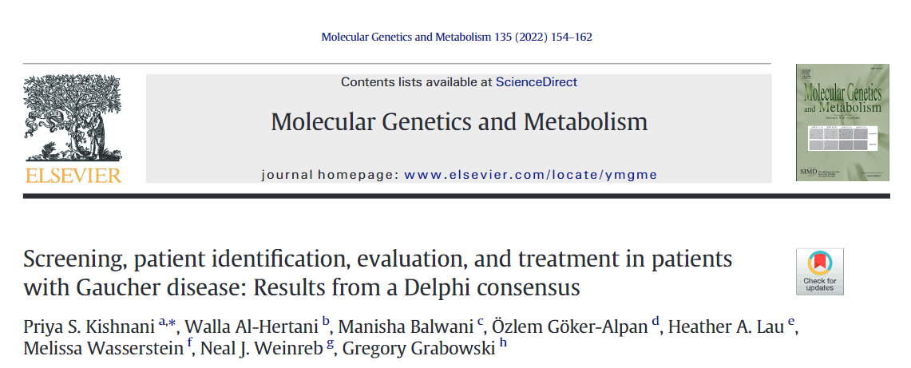
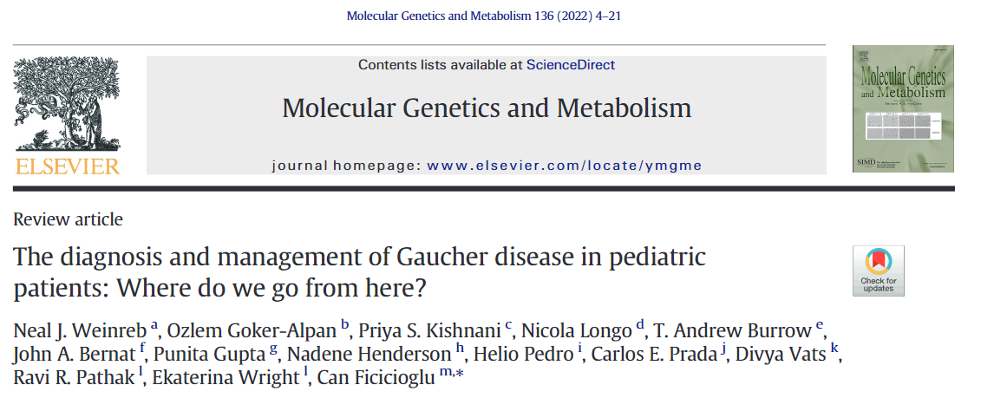
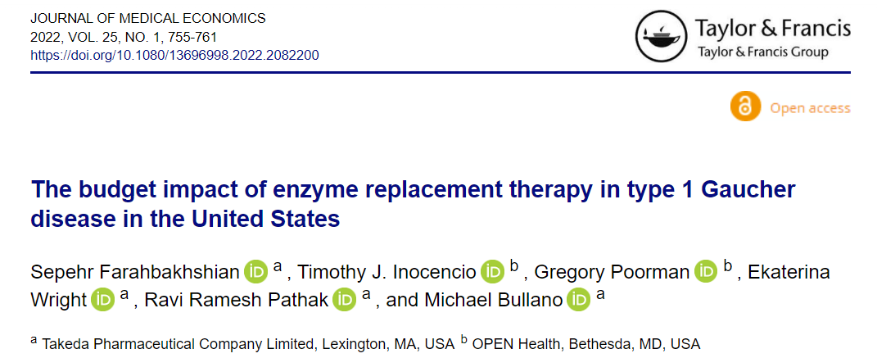
Real world evidence
US-GOS Pediatric Data/Outcomes
US-HOS Pediatric Data/Outcomes
VPRIV Switch Study
VPRIV Pediatric Study
MPSII Digital Platform/Care-Giver Engagement

Slide 6
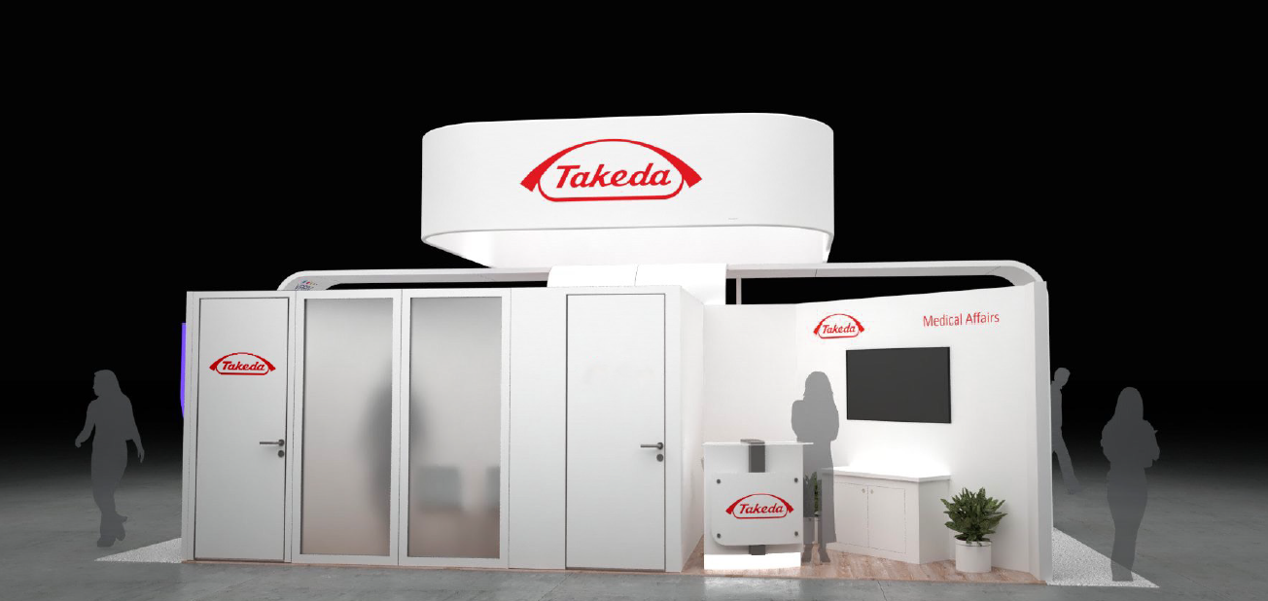
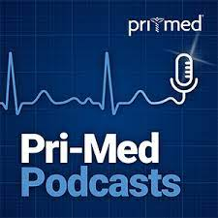


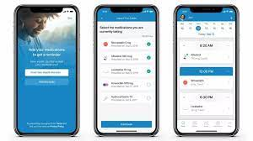


Strategic planning
Conference Planning
Clinical Studies
Advisory Boards
Educational Outreach
Digital Engagement
Medical Insight Gathering

Slide 7
Operations management
Project
Management
Budget Planning
Cross-functional alignment
Forecasting
SOP Development
Scheduling
Procurement
Process
Management
Data Management

Slide 8
Innovation and startup Experience

Slide 9
Technology and Product Development
Developed platform technology and companion bioassays for cancer research
Pan-cancer model.
Converts 2D cell line into vascular 3D tumors.
High take-rate >80% for PDX.
4X faster and 1/1oth the cost compared to mouse models
In vivo model for bioassays such as:
CAR T-Cell therapy screening
Distant Organ Metastasis
Bone Metastasis
Angiogenesis
Drug Sensitivity
https://www.bcm.edu/research/advanced-technology-core-labs/lab-listing/pdxavm

Slide 10
Commercialization and Marketing Experience
Developed commercialization strategy for Ovodex – a startup around chicken egg-based cancer models (Finalist in OneStart technical startup competition).
Completed product development and fund-raising from Baylor College of Medicine to provide turnkey service to clients through an Advanced Technical Core.

